Slide 1

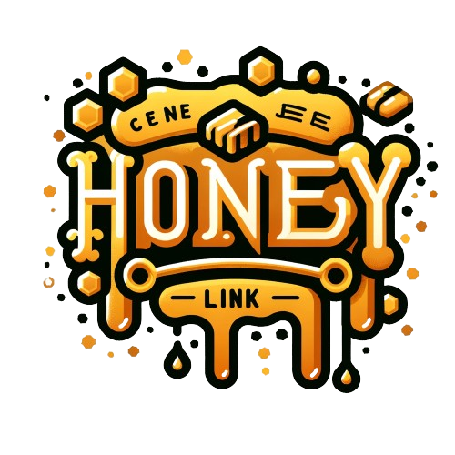
More than just a digital pet.

Slide 2


ABOUT
HoneyLink is a Web 3.0 social gaming application that leverages the Telegram ecosystem for digital pet nurturing, battling, and trading, with AI capabilities endowing each pet with a unique personality.
Unlike traditional virtual pets, Gaimon stands out with its distinctive characters and allows users to form teams within Telegram groups for adventures, providing a chance at earning rewards.

Slide 3

What is a Gaimon?
Each Gaimon comes with a randomly assigned unique personality, which you will delight in discovering during your interactions with them.
Gaimons can form various alliances within Telegram groups, collaborate on expeditions throughout the world, and yield considerable profits for you based on their Combat Ability and the HCoins you pledge.

Slide 4
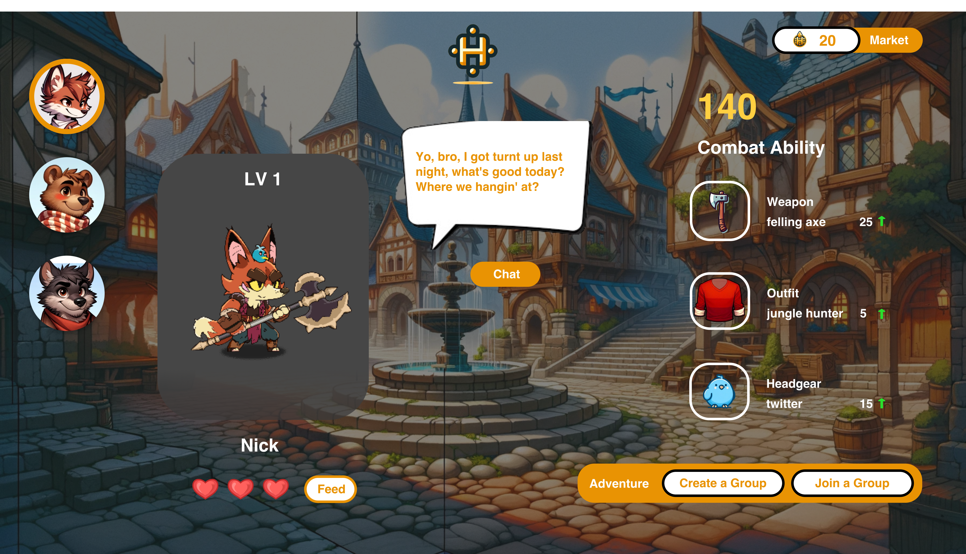

Slide 5
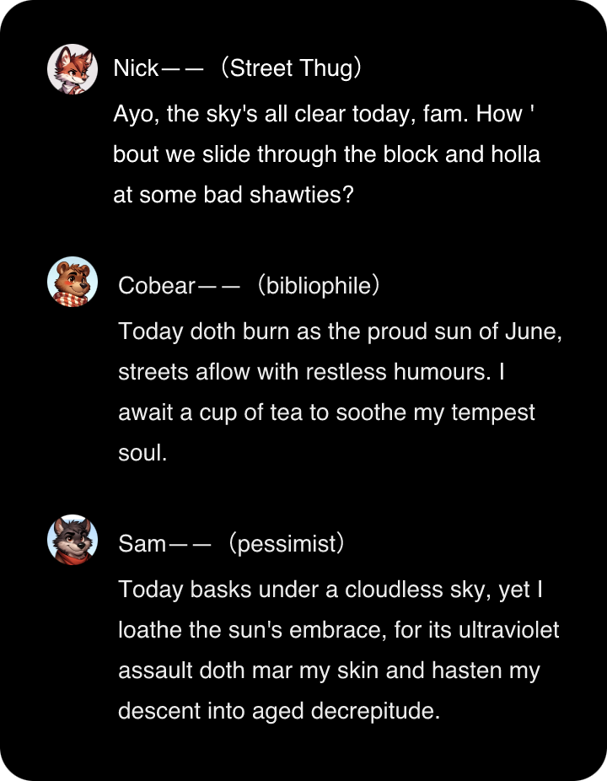
How do Gaimons communicate?
Gaimon are programmed with randomized personalities upon creation, including traits like optimism, pessimism, social anxiety, and enthusiasm, with chances to unlock even rarer characteristics.
The diversity in traits makes interactions with Gaimon uniquely enjoyable. To explore varying experiences, you can upgrade and modify your Gaimon's personality.

Slide 6
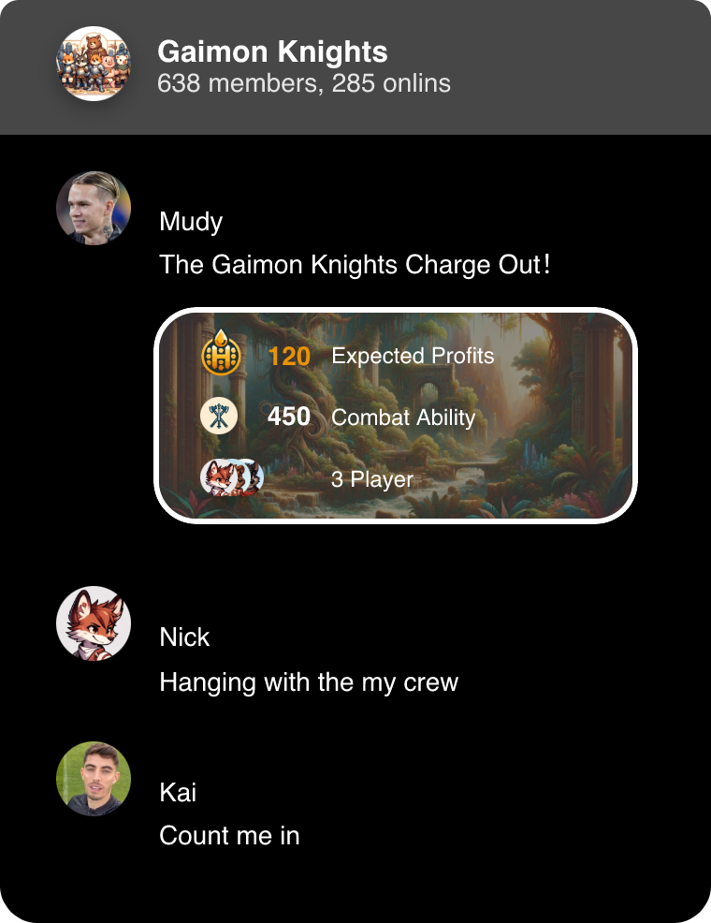
How can Gaimon make money for me?
Gaimon will organize team adventures based on Telegram groups, where the earnings are determined by two rules:
1、The Combat Ability of the Gaimons participating in the team adventure.
2、The Hcoins staked by users participating in the team adventure.
The platform will match the corresponding returns based on these two factors, and the total earnings will also be distributed among the participants according to these factors.

Slide 7
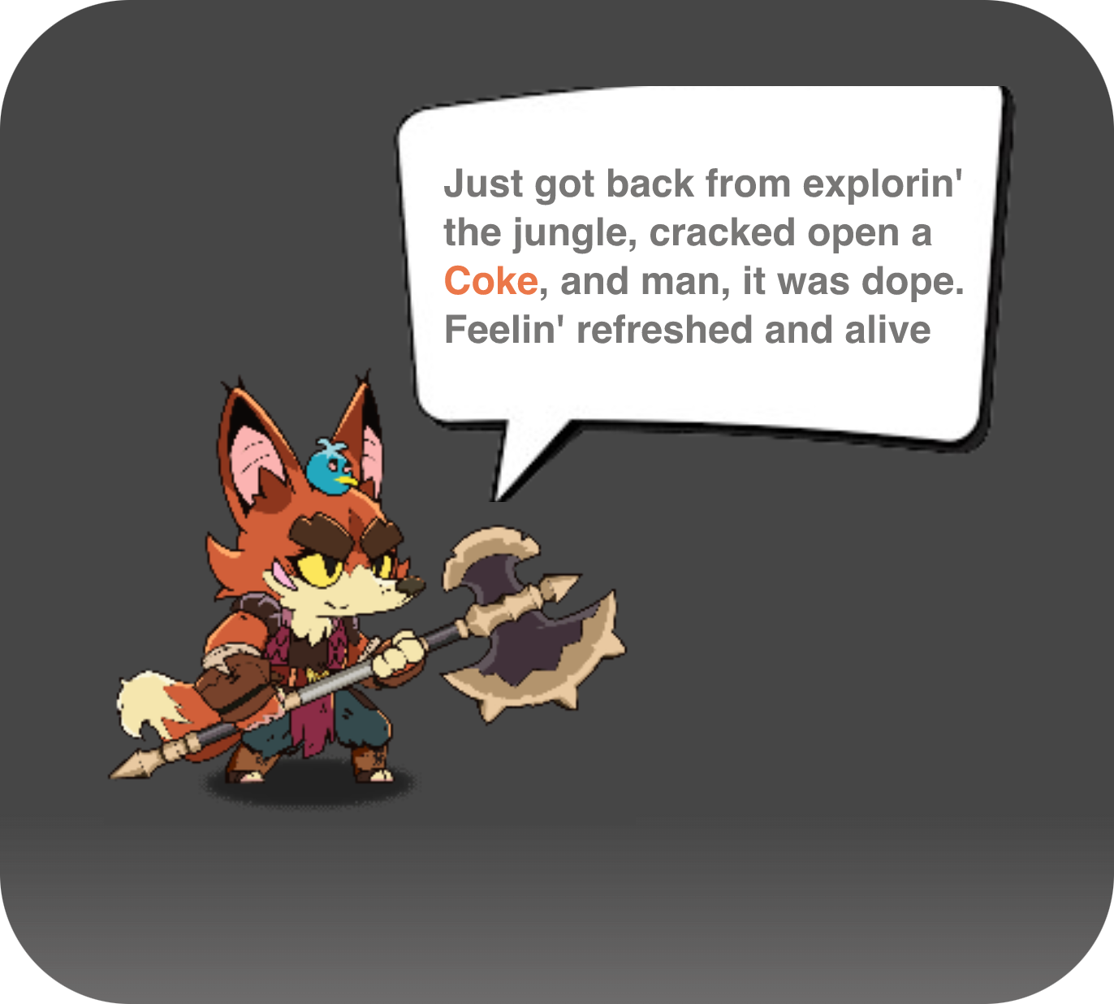
Undertaking advertising for private domain traffic
Through the growth of the ecosystem based on Telegram groups, HL will also gain a substantial amount of private domain traffic. At this point, HL can introduce advertising as a source of platform revenue distribution. The advertisements will be seamlessly integrated into Gaimon's team adventure narrative based on AI capabilities, and we will also explain this to our users

Slide 8
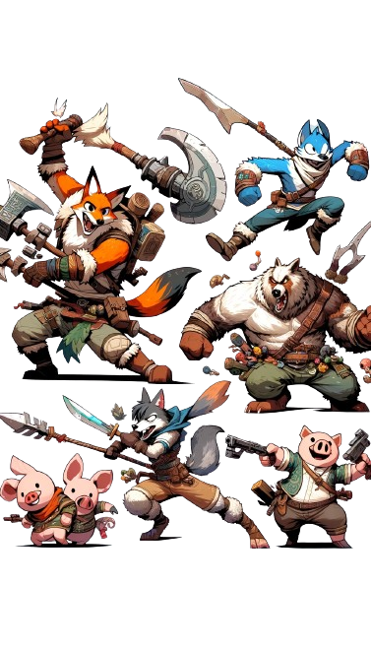
There's also more thrilling PvP gameplay.
HL will introduce a seasonal approach to large-scale group PKs , periodically allocating a portion of HCoins to invite groups to compete in time-limited challenges, scenario-based achievement races, and random team matches. This not only enhances intra-group interaction but also promotes healthy competition and communication between groups

Slide 9
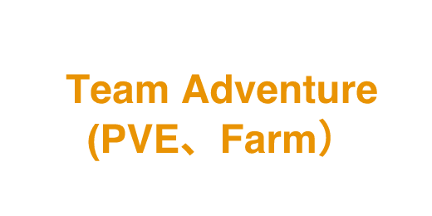



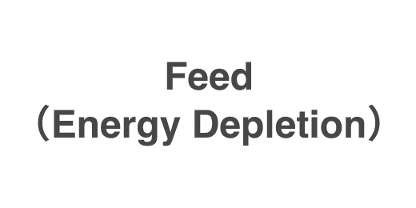
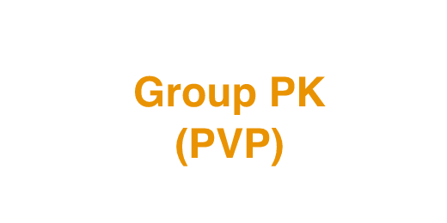




How HCoins are used and circulated

Slide 10
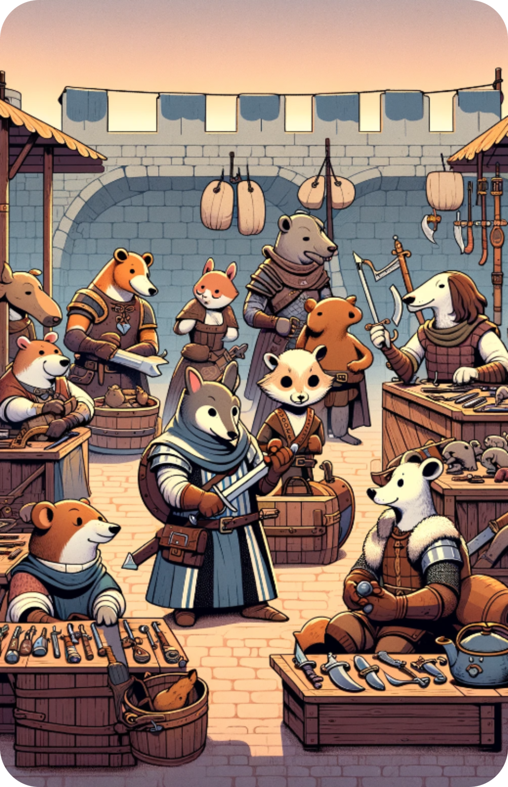

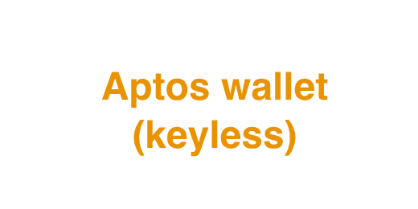
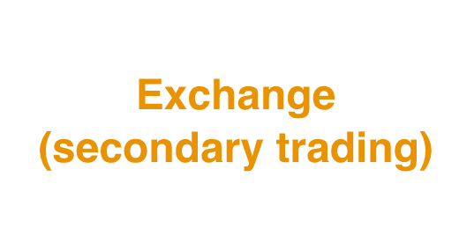
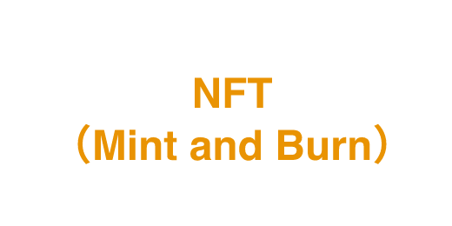







How it's technically done
Aptos
AI Engineering
Game

Slide 11


Marketing Strategy
By using the product's implicit LGBT-friendly attributes, we can tap into the social and entertainment aspects of certain niche communities.
Fully leverage Telegram's 900 million daily active users by utilizing the product's strong social features to grow group-based private traffic.

Slide 12


LEADING TEAM
Sherc
BeiChen
Product VP of Xing Shi（Post-2000s social interaction.）
Principal of the NICE trend community
Product architect at JD.com
Influencer in the field of youth culture.
MEM degree from Peking University
Former L9 engineer at MeituanProduct
Holding an ideal to change the world through technology

